Slide 1
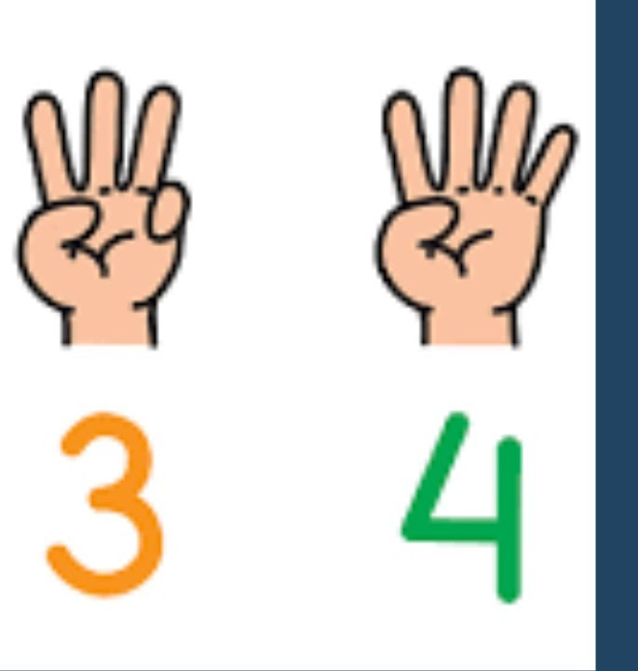
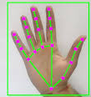
Finger Detection and counting Python project sem 4
AP23110011150 – O. Lokeshwar Reddy
AP23110011163 – K. Sri Akshaya
AP23110011212 – Mehrosh Sultana
AP23110011213 – R. Phani Sree
B.Tech CSE-Q

Slide 2
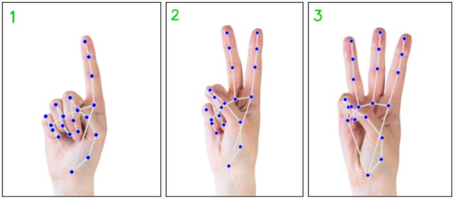
Introduction
use AI to detect human hand movements implemented by Python language
helpful for gesture recognizing and sign language interpreting(translating)
used in touchless technology that works with gestures, and in making technology for differently abled people
real time video input through webcam, processing the video frame, then displaying the count on the live video stream

Slide 3


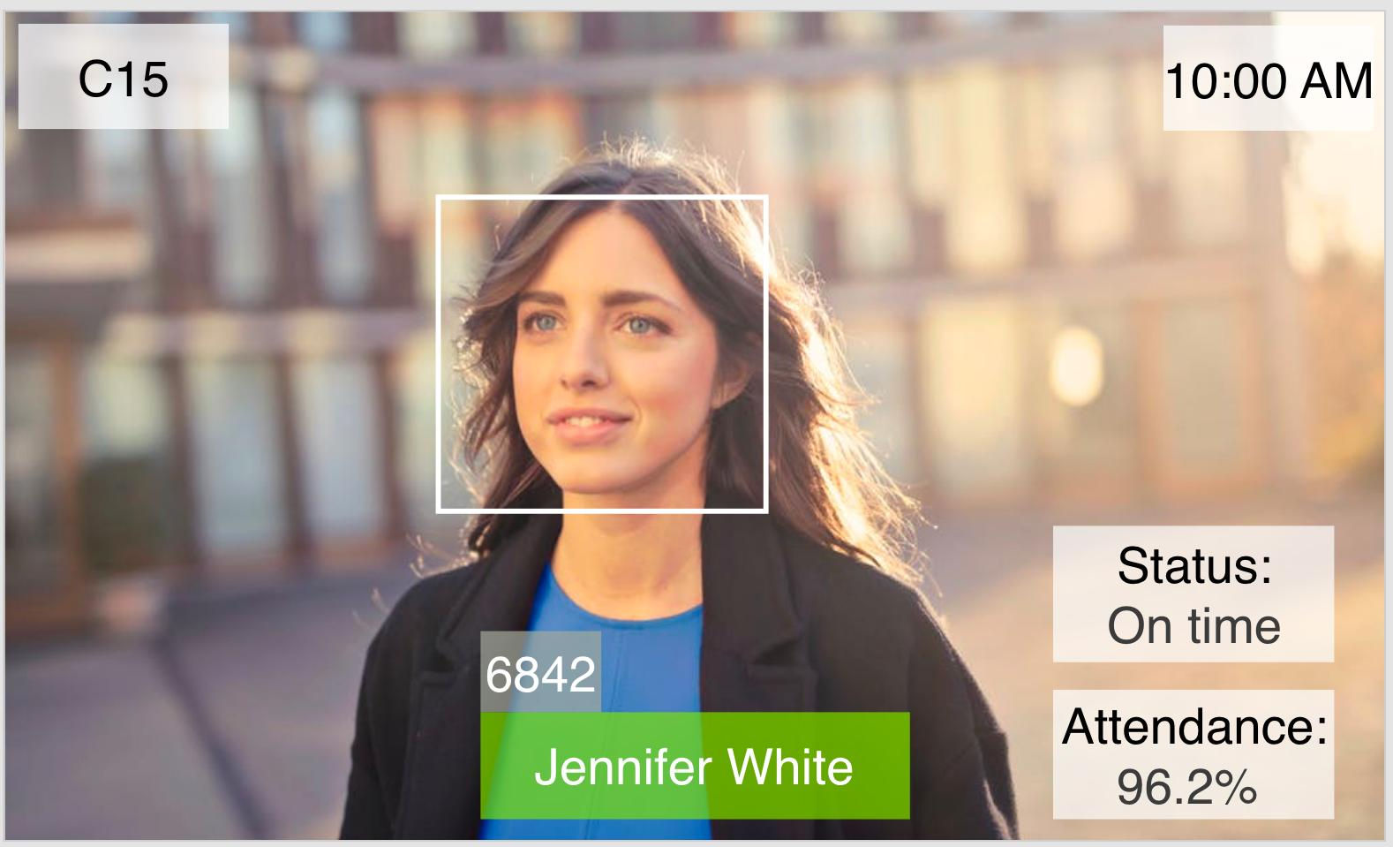
Libraries used
MEDIAPIPE – in alpha stage from google
For video processing
detecting and counting the fingers
CV2 – provided by opencv.org
For webcam
Capturing video

Slide 4
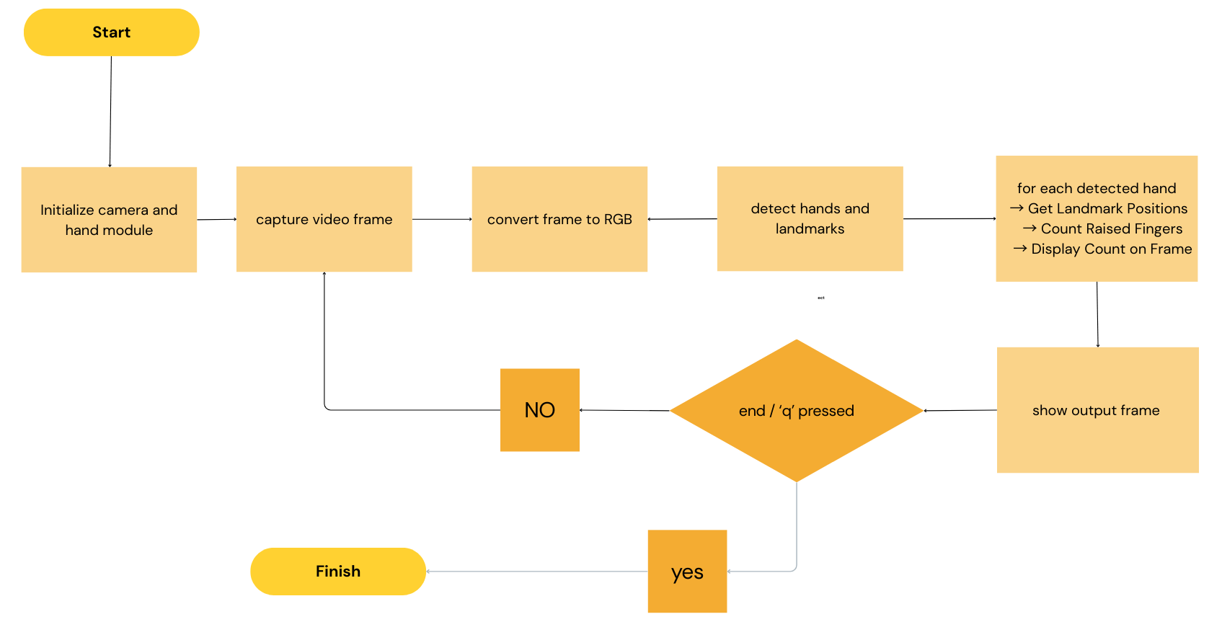
workflow

Slide 5
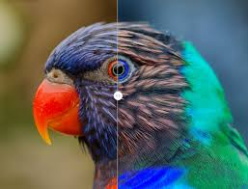
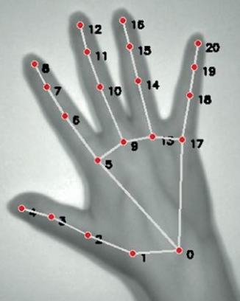
process
Capture video frame
Process the frame (BGR to RBG)
Find the pixel position of hand then fingers
Mark finger landmarks with index 0-20 (21 marks) -- palm is in centre with index 0 then fingertips are [4,8,12,16,20]
Detect the number of open thumbs – compare with x-axis
Detect number of open fingers – compare with y-axis
Display on top left of the video stream
BGR → RBG
Land marking indices on detected hand

Slide 6
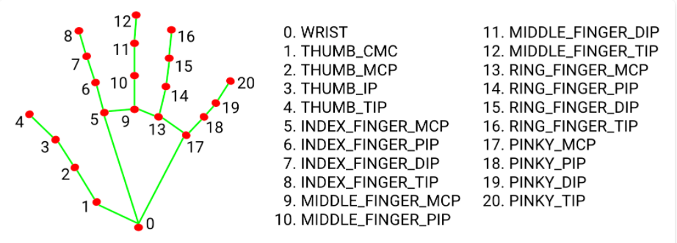
Finger detection and landmarking

Slide 7
Functions used – from cv2
mp.solutions.hands.Hands(): Initializes the hand tracking model with given configuration. Syntax: mp_hands.Hands(static_image_mode, max_num_hands, min_detection_confidence, min_tracking_confidence).
hands.process(): Processes the input image and returns hand landmarks if detected. Syntax: hands.process(image).
mp.solutions.drawing_utils.draw_landmarks(): Draws the landmarks and connections on the hand. Syntax: mp_draw.draw_landmarks(image, hand_landmarks, connections).

Slide 8
From OpenCV (cv2):
cv2.VideoCapture(): Used to capture video from the webcam. Syntax: cv2.VideoCapture(0) where 0 is the index of the camera.
cv2.cvtColor(): Converts an image from one color space to another. In your code, it converts the image from BGR (default OpenCV color space) to RGB (used by MediaPipe). Syntax: cv2.cvtColor(image, cv2.COLOR_BGR2RGB).
cv2.circle(): Draws a circle on an image. This is used to mark the landmarks on the detected hand. Syntax: cv2.circle(image, (cx, cy), radius, color, thickness).
cv2.rectangle(): Draws a rectangle on an image. Used to display the box behind the finger count text. Syntax: cv2.rectangle(image, pt1, pt2, color, thickness).
cv2.putText(): Puts text on an image. Syntax: cv2.putText(image, text, position, font, font_size, color, thickness).

Slide 9
6. cv2.imshow(): Displays an image in a window. Syntax: cv2.imshow(window_name, image).
7. cv2.waitKey(): Waits for a key event for a specified time. It’s used to check if the 'q' key is pressed to quit the loop. Syntax: cv2.waitKey(1).
8. cv2.VideoCapture.release(): Releases the video capture object, freeing up the camera. Syntax: video_capture.release().
9. cv2.destroyAllWindows(): Closes all OpenCV windows. Syntax: cv2.destroyAllWindows().

Slide 10
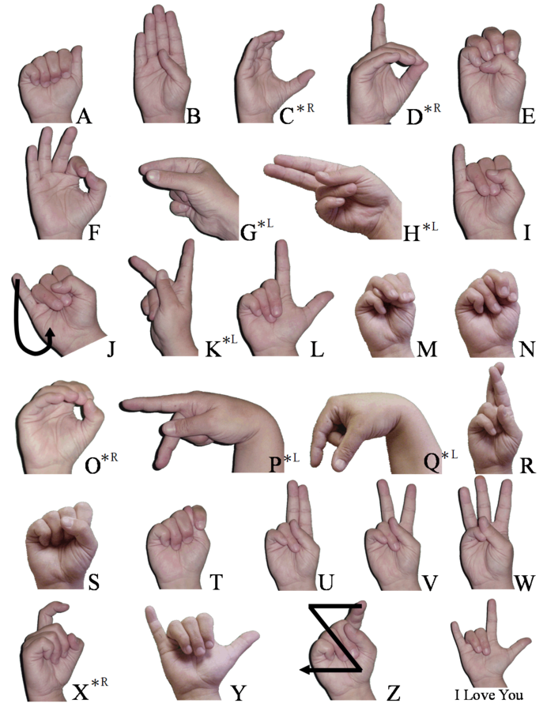
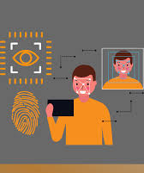
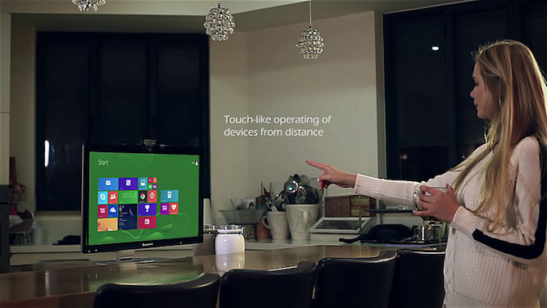
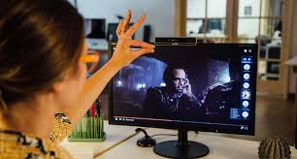
APPLICATIONS
SIGN LANGUAGE INTERPREATION
TOUCHLESS USER INTERFACE
BIOMETRIC AUTOMATION
MEDICAL IMAGING
ROBOTICS
GESTURE CONTROLLED TECHNOLOGY

Slide 11
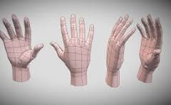
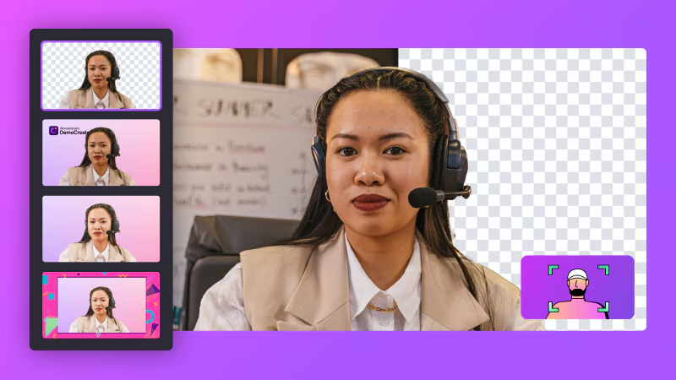
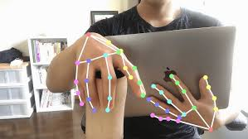
FUTURE SCOPE
3D HAND MODELLING – to avoid finger positioning error(finger behind finger is not detected using this program)
ERROR HANDLING & ROBUSTNESS – to avoid background interference due to lighting
HAND GESTURE RECOGNITION – capture hand movements to understand the gesture
MULTI HAND TRACKING – this project gives error when detecting multiple hands

Slide 12
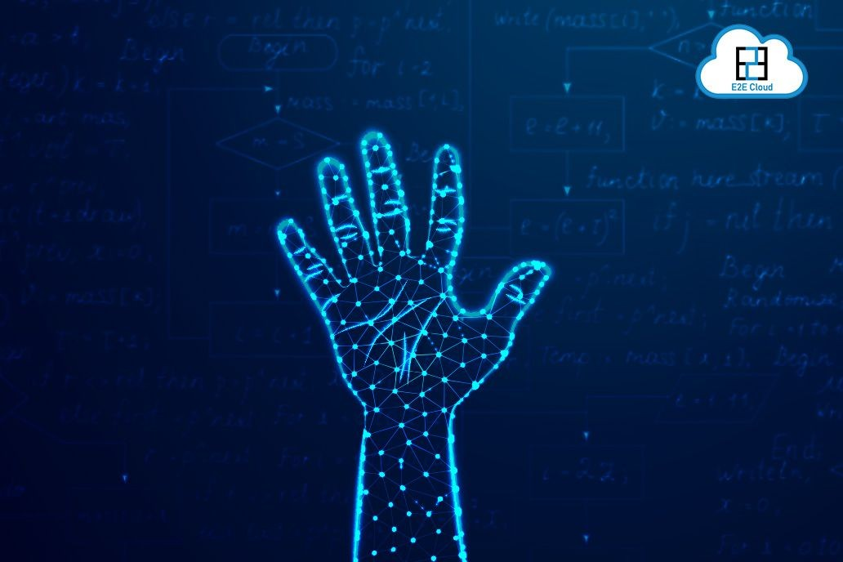
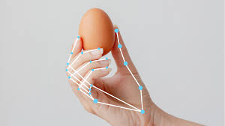
☺ ☺ THE End ☺ ☺

